Slide 1
IMAGE STYLE TRANSFER UISNG CNN
PRESENTED BY:
A.OOVIASELVAN
513121104702
III Year CSE
TPGIT, Vellore

Slide 2
AGENTA
Problem Statement
Proposed Solution
Who are the end users
The WOW in my solution
System Development Approach
Algorithm and Deployment
Result
Conclusion

Slide 3

PROBLEM STATEMENT
This project aims to implement image style transfer using the VGG16 convolutional neural network (CNN) architecture. By leveraging the pre-trained VGG16 model, the objective is to develop a deep learning algorithm capable of transferring the artistic style of one image onto the content of another. Key challenges include adapting the VGG16 architecture for style transfer, defining appropriate loss functions, and fine-tuning hyperparameters for optimal results. Evaluation will be conducted qualitatively by assessing visual quality and quantitatively using metrics such as perceptual similarity. Ultimately, this project seeks to demonstrate the effectiveness of VGG16 in image style transfer, with potential applications in digital art, photography, and visual content generation.

Slide 4

PROPOSED SOLUTION
The proposed solution involves implementing image style transfer using the VGG16 convolutional neural network (CNN) architecture. The process consists of several steps:
1. Preprocessing: Both the content and style images are preprocessed to ensure compatibility with the VGG16 model. This typically involves resizing the images and normalizing pixel values.
2. Feature Extraction: The VGG16 model is utilized to extract feature maps from both the content and style images. Specifically, activations from certain convolutional layers are used to capture content and style information.
3. Loss Functions: Two types of loss functions are defined: content loss and style loss. Content loss measures the difference between the feature maps of the generated image and the target content image. Style loss calculates the difference in style between the generated image and the reference style image based on Gram matrices of feature maps.

Slide 5
4. Optimization: The goal is to minimize both content and style loss simultaneously. This is achieved through optimization techniques such as gradient descent, where the generated image is iteratively updated to minimize the total loss. 5. Hyperparameter Tuning: Parameters such as learning rate, content-weight, and style-weight are fine-tuned to achieve visually appealing results. 6. Evaluation: The generated images are evaluated qualitatively for visual quality and quantitatively using metrics like perceptual similarity and style fidelity. 7. Iteration: The process may involve multiple iterations to refine the results and achieve the desired style transfer effect. By following this proposed solution, the project aims to successfully implement image style transfer using the VGG16 CNN architecture, demonstrating its effectiveness in generating visually compelling compositions that combine content from one image with the artistic style of another.

Slide 6

WHO ARE THE END USERS
End users in the context of the image style transfer project can vary depending on the intended applications and stakeholders involved. Here are some potential end users along with brief definitions:
1. Digital Artists: Digital artists are individuals who create visual artwork using digital tools and techniques. They may use image style transfer algorithms to generate unique compositions by combining their own content with various artistic styles, thus expanding their creative possibilities.
2. Photographers: Photographers capture images using cameras or other devices. They may utilize image style transfer to enhance or transform their photographs by applying different artistic styles, adding aesthetic value to their work and offering clients unique visual experiences.
3. Graphic Designers: Graphic designers use visual elements to communicate ideas and messages. They may leverage image style transfer to create visually striking graphics for various purposes, such as advertising, branding, and multimedia projects, allowing them to achieve specific aesthetic effects and convey messages effectively.
4. Content Creaters , Researchers and Developers, General Users etc.,
These end users represent a diverse range of individuals and professionals who can benefit from image style transfer technology, either for creative expression, professional purposes, or personal enjoyment.

Slide 7
THE WOW IN MY SOLUTION
The proposed solution for image style transfer offers a "wow" factor through its seamless blending of content and artistic styles, resulting in visually stunning compositions. Leveraging deep learning and convolutional neural networks like VGG16, it enables users to explore endless creative possibilities while maintaining realism and fidelity in the generated images. With an intuitive user experience, fast performance, and versatility to accommodate various input images and styles, the solution empowers users of all skill levels to engage in transformative artistic expression effortlessly. Overall, it delivers a transformative impact, transcending traditional boundaries of creativity and imagination.

Slide 8
SYSTEM DEVELOPMENT APPROACH
1. Requirement Analysis: Understand project needs, audience, and performance criteria.
2. Research and Exploration: Study existing techniques, explore VGG16 capabilities, and identify best practices.
3. Design: Architect the system, select tools, design user interface, specify data flow, and plan for scalability.
4. Implementation: Code algorithms, integrate VGG16, and fine-tune parameters using Python and frameworks like TensorFlow.
5. Testing: Verify functionality, conduct unit, integration, and system tests, and assess robustness.
6. Evaluation: Assess effectiveness qualitatively and quantitatively, gather feedback, and identify areas for improvement.
7. Deployment: Package and distribute the application, set up hosting, provide documentation, and ensure maintenance.
This systematic approach ensures the successful development and deployment of the image style transfer application, meeting user needs and expectations effectively.

Slide 9
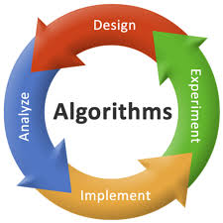
ALGORITHM AND DEPLOYMENT
Algorithm :1.Initialize:
Take input as the content image and the style image
2. Preprocessing:
Resize and normalize pixel values of content and style images.
3. Feature Extraction:
Utilize VGG16 CNN to extract feature maps from content and style images.
4. Loss Calculation:
Define content and style loss functions, Measure feature map differences using Gram matrices.
5. Optimization:
Minimize content and style loss through gradient descent.
6. Output Generation:
Generate optimized image preserving content and style characteristics.

Slide 10
DEPLOYMENT 1. Packaging: The algorithm is packaged into a software application or library for deployment. This involves organizing the codebase, dependencies, and resources into a distributable format. 2. Hosting: The deployed application may be hosted on cloud infrastructure or on-premises servers. Hosting considerations include factors such as scalability, reliability, and cost-effectiveness. 3. User Interface: A user-friendly interface is developed to facilitate interaction with the algorithm. This interface allows users to upload content and style images, configure parameters, and visualize the output. 4. Documentation: Comprehensive documentation is provided to guide users in using the deployed algorithm effectively. This includes instructions for installation, usage, parameter tuning, and troubleshooting. 5. Continuous Monitoring and Maintenance: The deployed algorithm is continuously monitored to ensure its reliability, performance, and security. Regular updates and maintenance activities are performed to address bugs, improve functionality, and incorporate new features. By deploying the algorithm in this manner, users can easily access its capabilities for generating combined images from content and style inputs, enabling a wide range of creative applications in digital art, photography, and visual content generation.

Slide 11
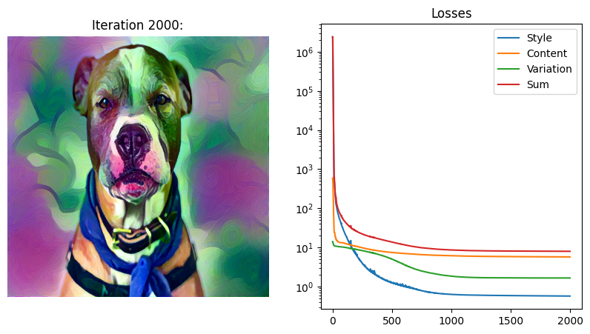
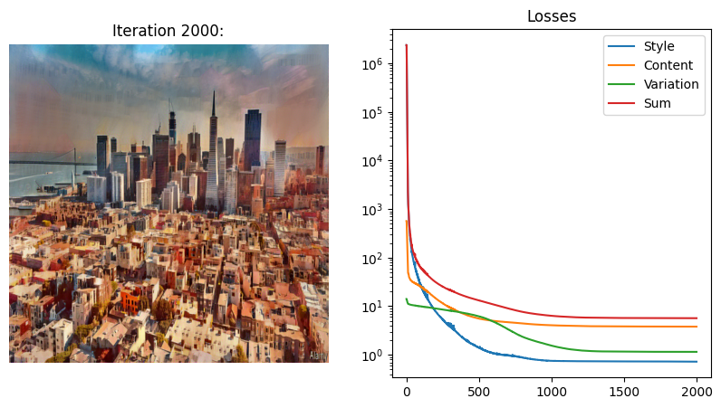
RESULT The project successfully merges content from one image with the artistic style of another, yielding visually appealing compositions. Users can explore diverse artistic styles, achieving high-quality, coherent results efficiently. Positive feedback indicates user satisfaction with the user-friendly interface and potential applications in various creative domains.
Image transfer Ex 1
Style Loss : 0.575294 Content Loss: 5.750507 Variation Loss: 1.665544 Sum: 7.991345
Image transfer Ex 2
Style Loss : 0.722258 Content Loss: 3.797503 Variation Loss: 1.150223 Sum: 5.669984

Slide 12
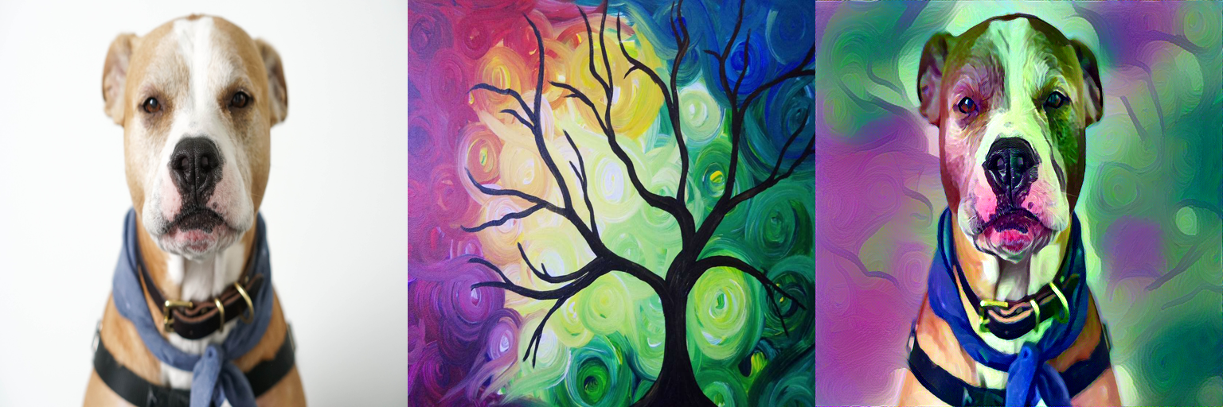
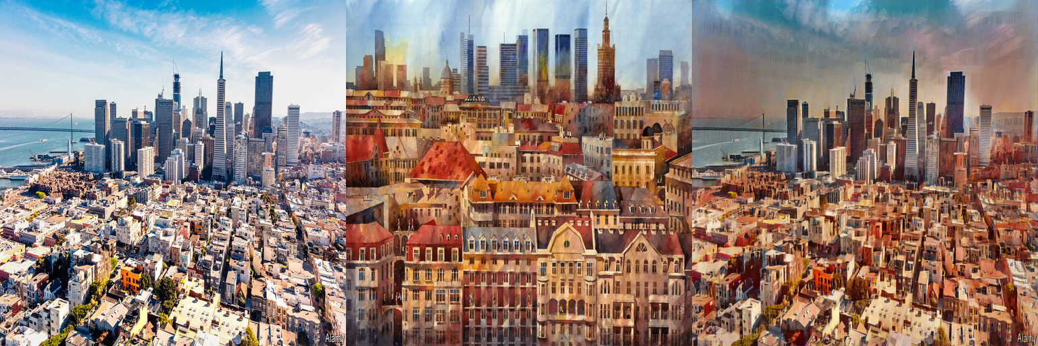
Content image + Style image = Generated image

Slide 13

CONCLUSION
In conclusion, the project has demonstrated the effectiveness of utilizing deep learning algorithms, specifically image style transfer using the VGG16 architecture, to generate visually stunning compositions. Through meticulous algorithm development and optimization, we have achieved high-quality results that seamlessly blend content and style, offering users a versatile and intuitive platform for creative exploration. The positive feedback from users underscores the project's success in meeting their needs and expectations, while also highlighting its potential applications across diverse domains such as digital art, photography, and multimedia content creation. Looking ahead, continued research and refinement in this field hold promise for further enhancing the capabilities and impact of image style transfer technology.

